Slide 1

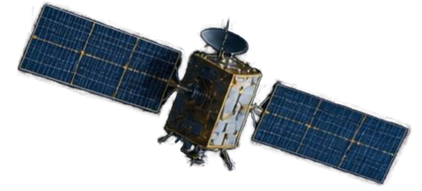
SUSTAINABILITY CREW
RIYADH
HEATMAP AI
SATELLITE EVIDENCE FOR COOLER URBAN
EXPANSION
A proof of concept for monitoring Riyadh hotspots
Team members:
Fatima alhaddad
Jawad alshakhahmad
Ghadeer madhoob
Hajar Majeedi
Dana Hussain

Slide 2


01 / WHY IT MATTERS
Heat is an urban design problem
-489,000 estimated heat-related deaths each year worldwide (2000–2019).
-WHO calls extreme heat a major climate and health risk.
-Riyadh adds a dense built environment, low vegetation and intense solar load.
-The same desert climate can feel radically different from one street to the next.

Slide 3
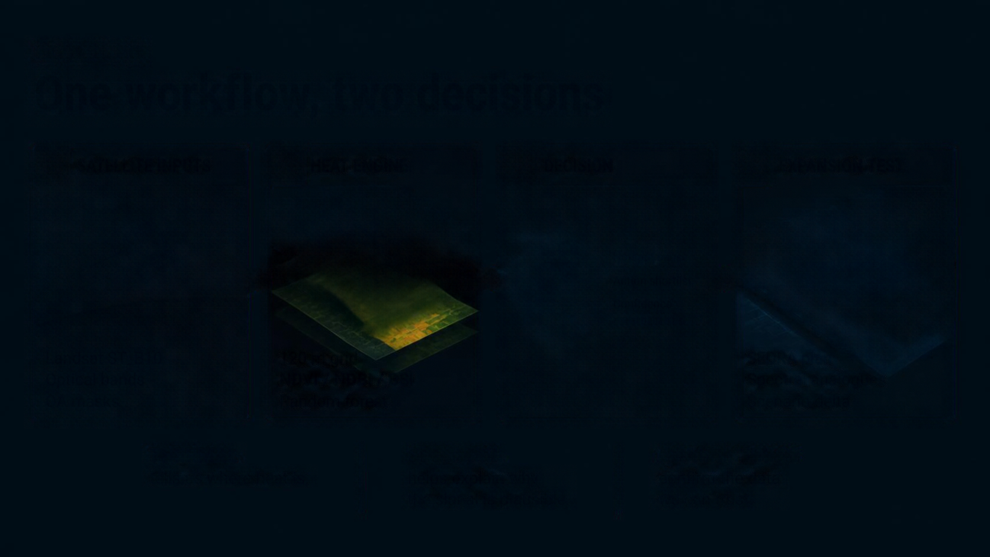








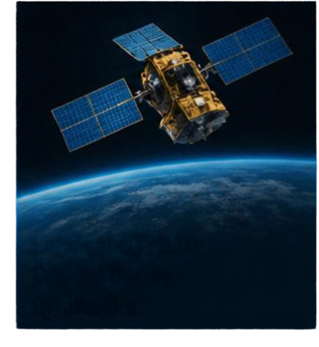
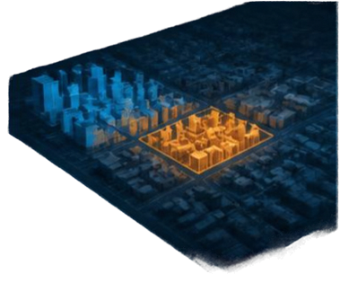
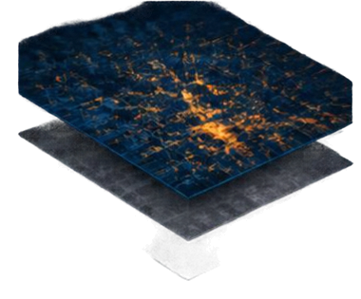
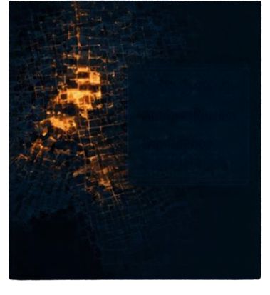




02 / SOLUTION
One workflow, two decisions
01
SATELLITE INPUTS
02
HEAT ENGINE
03
DECISION
04
EXPANSION TEST
Hotspot cause
Action shortlist
Confidence
120 m grid
NDVI / NDBI / BSI
Random forest
Landsat
Sentinel 2
THERMAL
SPECTRAL
QUALITY FLAGS
tells us where heat is
helps explain why the signal is plausible
confirm the data we can trust

Slide 4
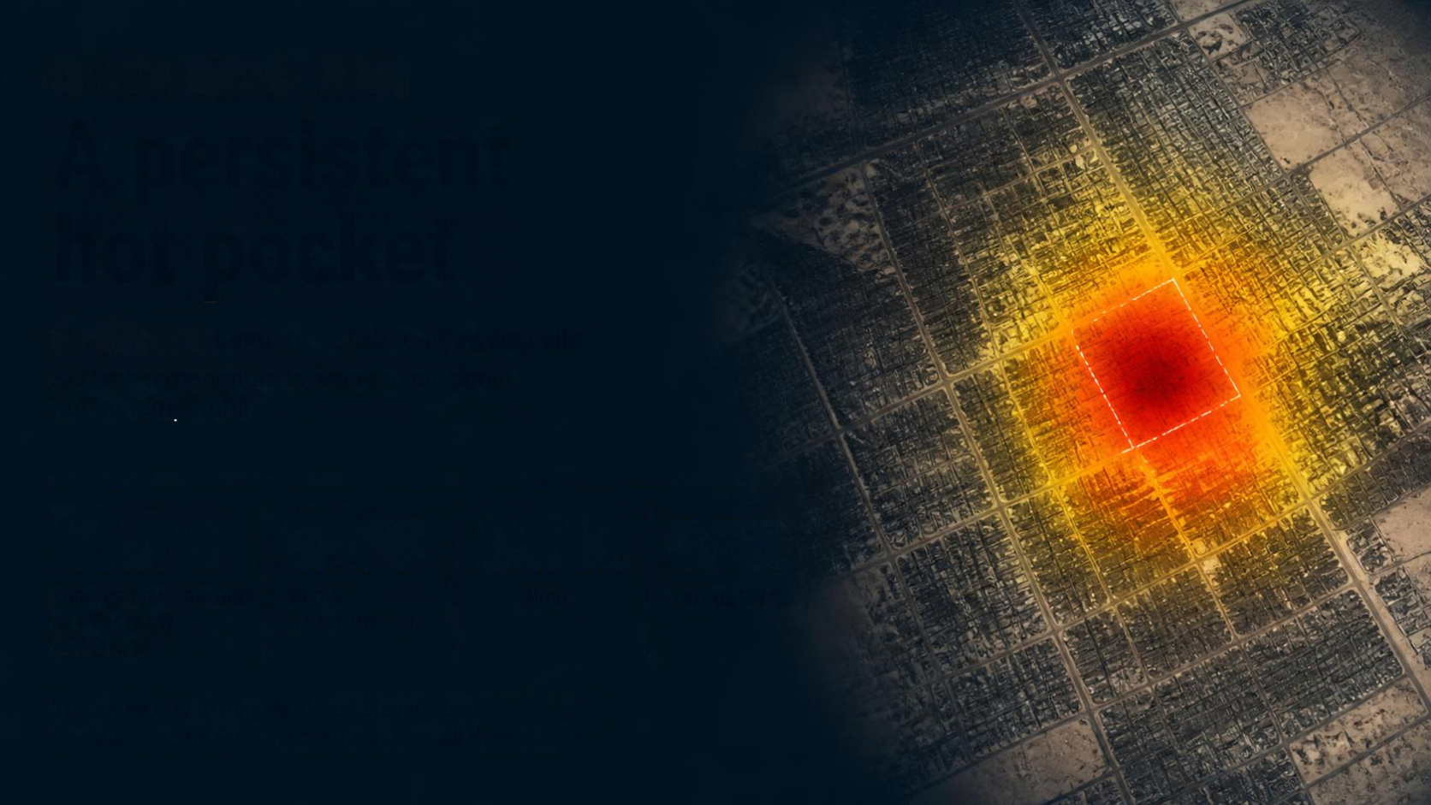
03 / FIELD EXAMPLE – RIYADH
A persistent hot pocket
22 July 2025 Landsat 8, 120 m analysis cells
Surface temperature is a screening signal, not air temperature.
54.6°C
3.5°C
0.043
3 / 3
SURFACE TEMPERATURE AT 24.6784°N, 46.74442°E
ABOVE STUDY MEDIAN
NDVI
HOT DATES
The same 600 m neighborhood stayed above
its date-specific 90th percentile across all three scenes.

Slide 5

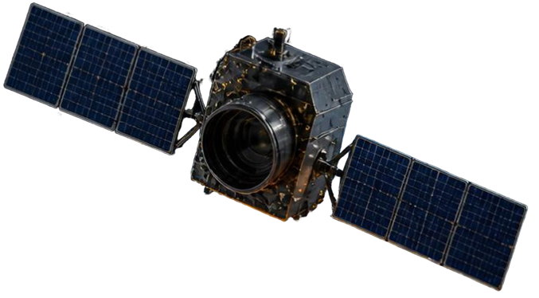

04 / PROOF OF CONCEPT
The baseline is measurable and honest
LST = DN × 0.00341802 + 149 – 273.15
LST CONVERSION
ST_B10 is scaled to °C. Cloud, shadow, saturation, aerosol and high ST_QA pixels are removed. The analysis aggregates to 120 m.
VALIDATION ON
HELD-OUT EASTERN RIYADH
1.94°C
2.17°C
–0.37
MAE
RMSE
R²
INPUTS RANKED BY
PERMUTATION IMPORTANCE
Visible brightness, BSI, NDBI, NDVI
While the R² highlights the complexity of urban microclimates, our low absolute error (1.94°C) establishes a reliable and transparent foundation for future model refinement.

Slide 6

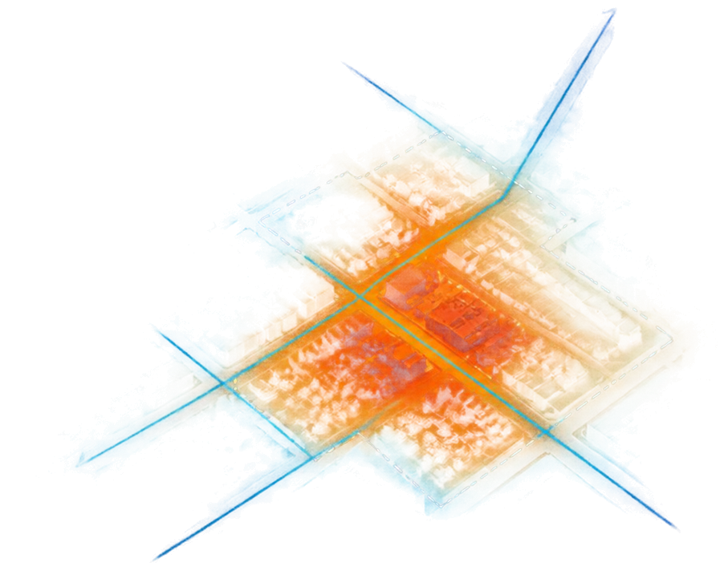
05 / IMPACT
Turn a hotspot into a design decision
Identify Priority Areas
Pinpoint persistent hotspots needing cooling interventions.
Guide Future Urban Expansion
Assess land-cover changes and heat risks before development.
Support Effective Cooling Strategies
Help planners prioritize vegetation, shading, and reflective materials.
Monitor Long-Term Impact
Monitor surface temperatures and intervention effectiveness over time.
0.79°C
modeled difference between two spectral mixes.

Slide 7


06 / SOURCES
Evidence behind the prototype
KEY DATA AND RESEARCH SOURCES
Copernicus Sentinel-2
https://dataspace.copernicus.eu/
Planet Tanager Hyperspectral
https://www.planet.com/
Landsat Program (NASA/USGS)
https://science.nasa.gov/mission/landsat/
NDVI (Normalized Difference Vegetation Index)
LULC (Land Use and Land Cover) Change Analysis
REPRODUCIBILITY
Reproduce: https://github.com/Mortrex12/riyadh-heatmap-ai
Full URLs and reproducibility files are included in the companion website.

